Slide 1
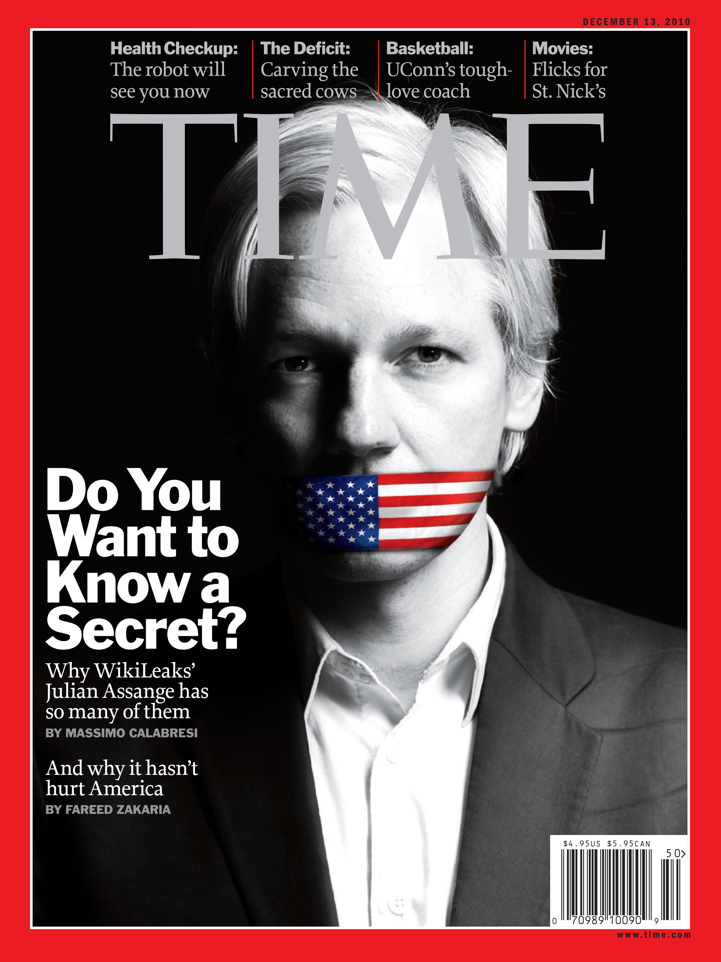
WikiLeaks – The Fifth Estate: Redefining Journalism in the Digital Age
Sarighioleanu Sebastian-Laurențiu
Ungureanu Matei-Ștefan

Slide 2

Section 1:
A New Era of Journalism
Section 2:
The Origin of Wikileaks
Section 3: Wikileaks major leaks
Section 4:
The arrest of Julian Assange and the successors of Wikileaks

Slide 3
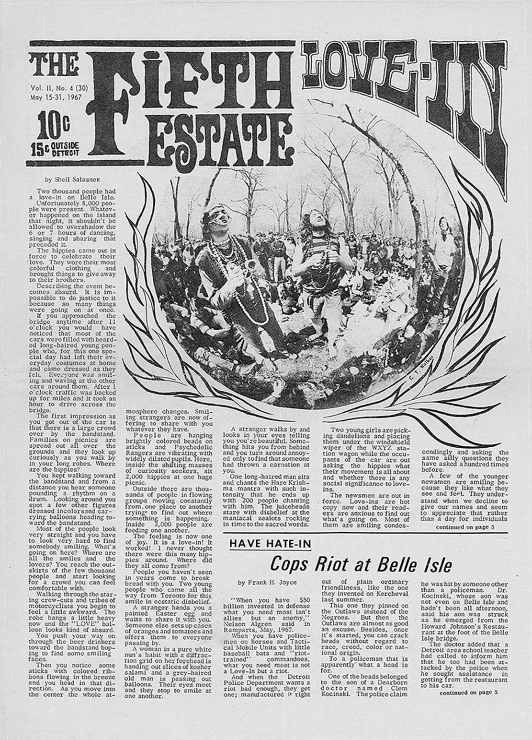
A New Era of Journalism
The "Fifth Estate" extends the sequence of the three classical Estates of the Realm (clergy, nobility, commoners) and the preceding Fourth Estate, essentially the mainstream press.

Slide 4
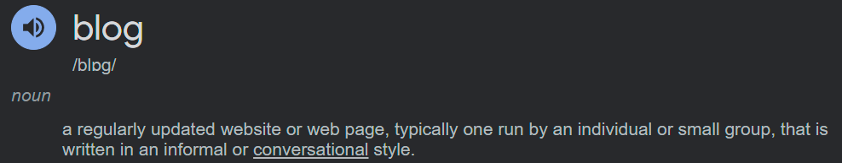
Blogs have several unique features that give them potential influence in policy making:
a lack of editorial supervision
low barriers to entry
difficulty for governments to censor or control content
the ease of responding to events in real time.

Slide 5

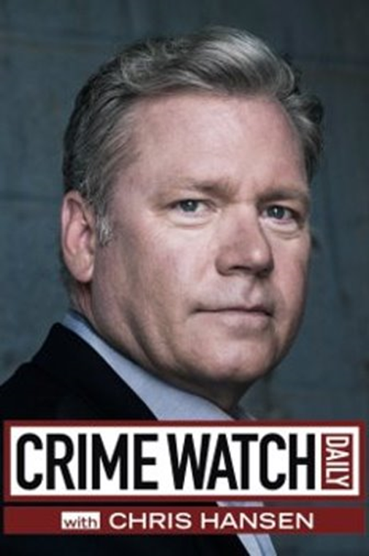
In journalism, there is a specific role that journalists may decide to take: investigative journalism.
Without it, citizens would be left in the dark about all the political issues, wrong-doings, and cover-ups that occur.

Slide 6

The Origin of Wikileaks

Slide 7
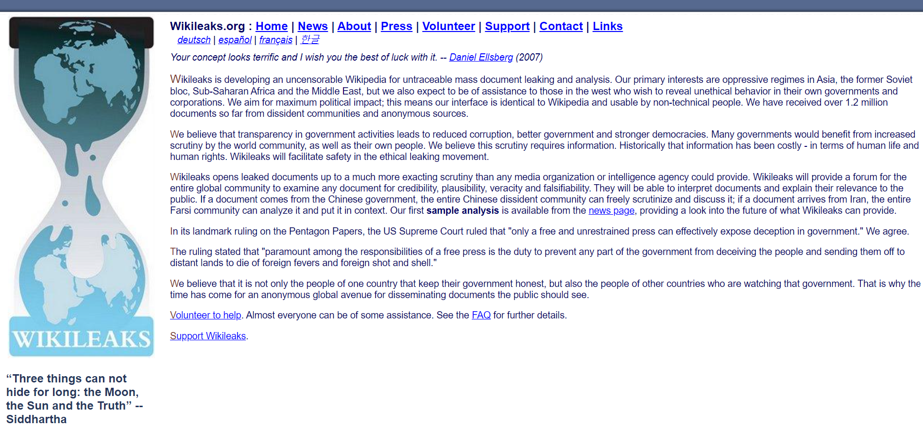
WikiLeaks is a multinational media organization and associated library. It was founded in 2006 by Julian Paul Assange, Australian editor, publisher, and activist.
WikiLeaks specializes in the analysis and publication of large datasets of censored or otherwise restricted official materials involving war, spying and corruption, describing itself as "an un-censorable system for untraceable mass document leaking". It has so far published more than 10 million documents and associated analyses.

Slide 8
Assange described WikiLeaks as an activist organization and said that "The method is transparency, the goal is justice". The motto was displayed on the WikiLeaks website when it first came online.
"WikiLeaks is a giant library of the world's most persecuted documents. We give asylum to these documents, we analyze them, we promote them, and we obtain more." - Julian Assange, Der Spiegel Interview

Slide 9

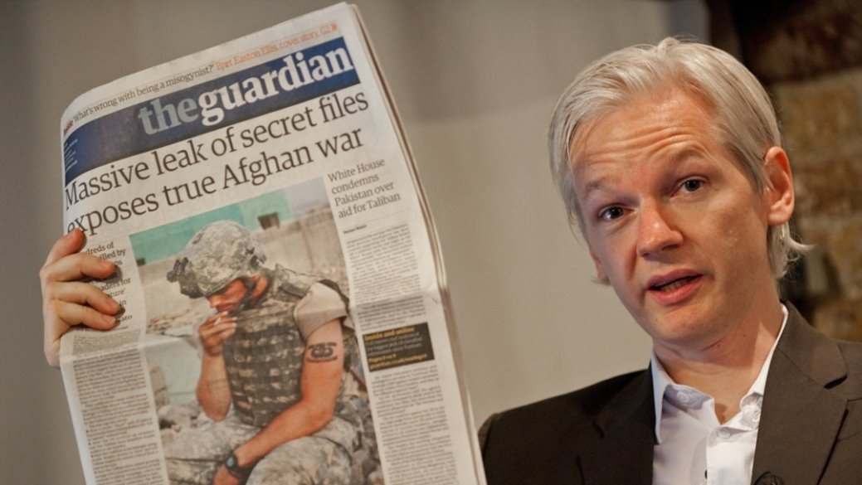

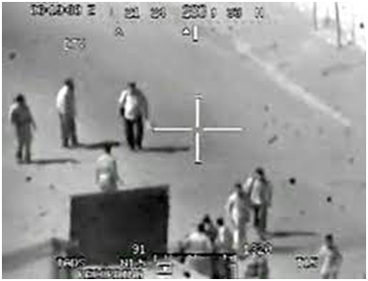
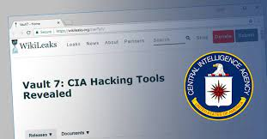
Wikileaks major leaks

Slide 10
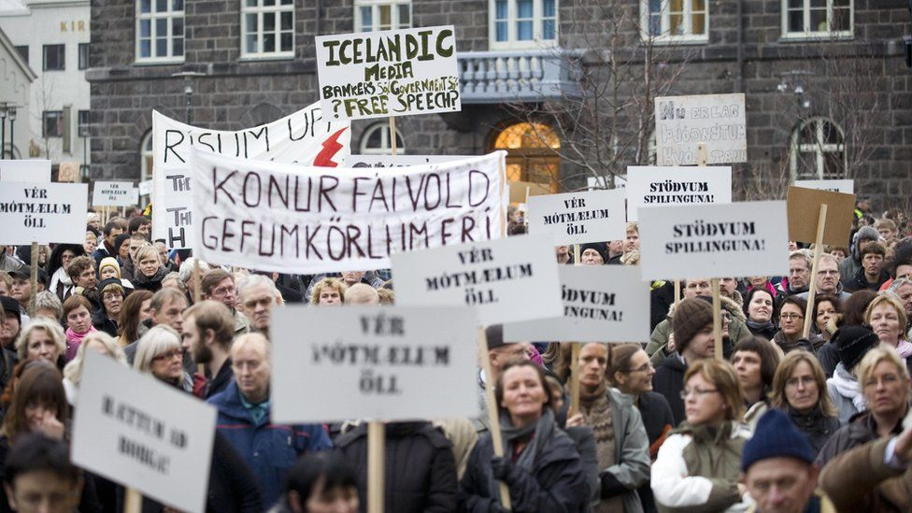
Icelandic Bank Files
"Icelandic Bank Files" is a series of confidential documents that were leaked in 2008 and 2009 during Iceland's financial crisis.

Slide 11
The biggest military leak in history​

Slide 12

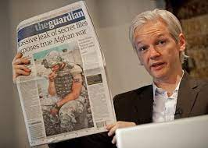
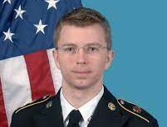
Afghanistan War Logs and Iraq War Logs
involves the release of the "Afghanistan War Logs" and "Iraq War Logs"​
Bradley Manning, a soldier in the US military, provided over 500,000 classified military documents to WikiLeaks + 250,000 confidential US diplomatic cables from 1966 to 2010

Slide 13
COLLATERAL MURDER

Slide 14

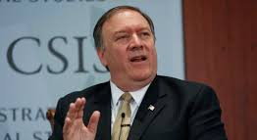
Vault 7
details about the activities and capabilities of the CIA to perform electronic surveillance and cyber warfare.
CIA director Mike Pompeo declared WikiLeaks to be a "hostile intelligence service" and considered kidnapping or assassinating Assange

Slide 15
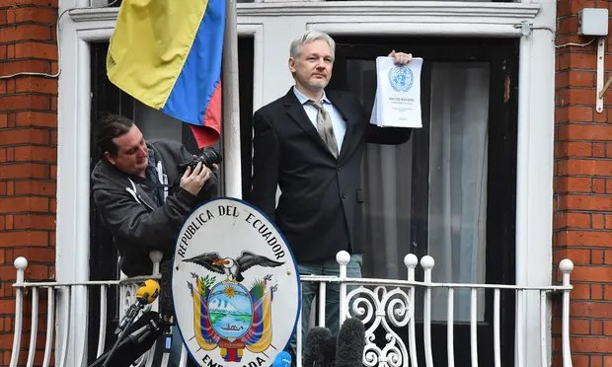
The arrest of Julian Assange

Slide 16
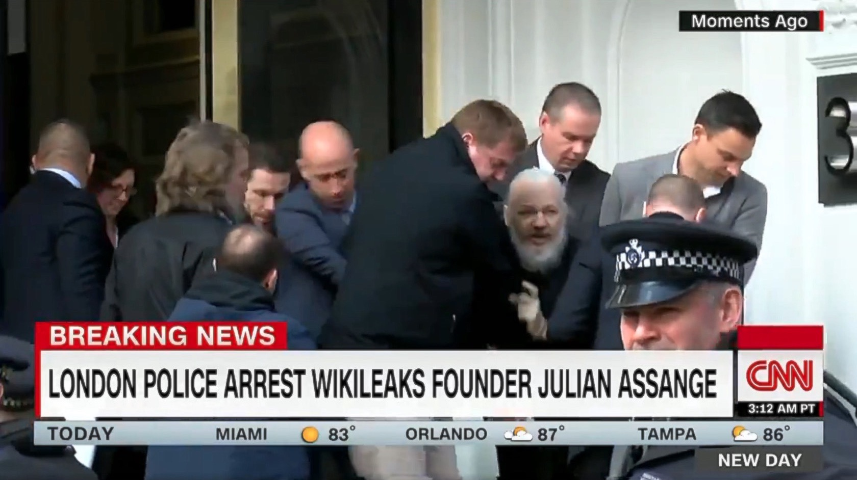

Slide 17
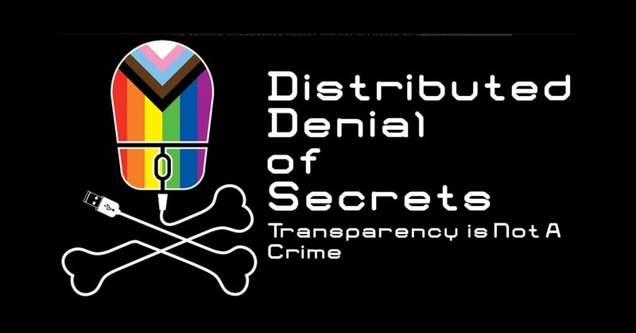


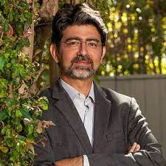
The successors of Wikileaks
Emma Best
Pierre Omidyar

Slide 18

"Publishing improves transparency"(Wikileaks)

Slide 19
Thank you!

